Slide 1

GUIDE FOR BLIND
Smart Blind Stick Using Arduino and Ultrasonic Sensor

Slide 2

INTRODUCTION:
AIM :
The study focus on a simple method of detecting the obstacle and route by using an ultrasonic sensor that can detect a hole or stair with maximum range about 2 meter. As we can see Blind people is having their trouble to do their life routines because they can’t see even a single things.
This ultrasonic blind stick have a several feature that surely can help this blind people to navigate routes and detect an obstacle that surely can make their life routines easier.
The user just need to use the blind the normal blind stick , the different is , blind people can detect a hole or stair more faster and easily.

Slide 3

OUR AGENDA IS…
This project intends to make ease for the optically defected people as a guide.
To make them feel confident enough to do their works on their own.
To help them to be aware of their surroundings as equally as a normal person.
To make them feel safe and secure to move around while walking
Keywords: Arduino uno, Ultrasonic sensors, RF transmitter and receiver

Slide 4

HOW DOES IT WORK…?
The Smart Blind Stick scans the path in front of it with the help of an HC SR04 Ultrasonic sensor.
Whenever the sensor detects any object in its path the buzzer starts beeping and also at the same time the LED turns on.
The blind person can hear the beeping of the buzzer and manage to change the way. In this way, the person can easily find his way without getting injured.
This smart stick works in the same way as the Ultrasonic range finder did. You can also see the real-time values of the distance in cm on the Arduino serial monitor.

Slide 5
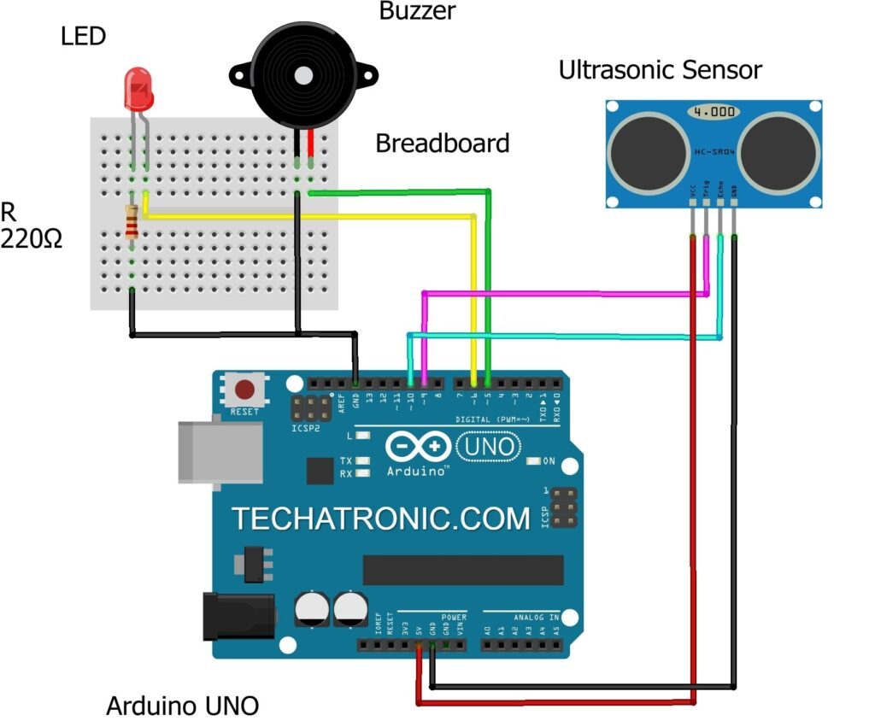
CIRCUIT DIAGRAM

Slide 6
WORKING MODEL
The main objective of this project is to help blind people to walk with ease and to be warned whenever their walking path is obstructed by obstacles. As a warning signal via buzzer, whose frequency of beep changes according to the distance of the object. The closer the distance of obstruction, the more will be the buzzer beep frequency.
The main component used for this device is the Ultrasonic Sensor HC-SR04. The ultrasonic sensor transmits a high frequency sound pulse and then calculates the time to receive the signal of the sound echo to reflect back. HC-SR04 has a transmitter & receiver surface. One of them acts as the transmitter and transmits the ultrasonic waves. The other one acts as a receiver and receives the echoed sound signal. The sensor is calibrated according to the speed of the sound in air. The speed of sound is 341 meters per second in the air, and the distance between the sensor and object is equal to time multiplied by the speed of sound divided by two.

Slide 7
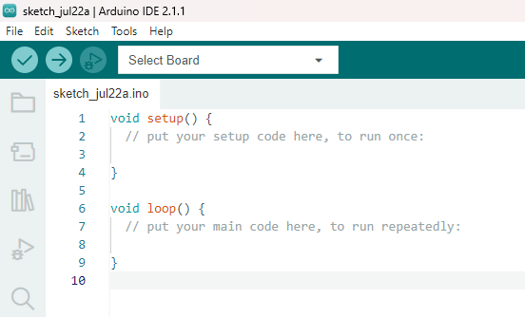
MODULE IMPLEMENTATION
Code:
const int trigPin = 9;
const int echoPin = 10;
long duration;
int distanceCm, distanceInch;
void setup()
{Serial.begin(9600);
pinMode(trigPin, OUTPUT);
pinMode(echoPin, INPUT);
pinMode(6, OUTPUT); // Connect LED Pin D6
pinMode(5, OUTPUT); // Connect Buzzer Pin D5
}
void loop()
{
digitalWrite(trigPin, LOW);
delayMicroseconds(2);
digitalWrite(trigPin, HIGH);
delayMicroseconds(10);
digitalWrite(trigPin, LOW);
duration = pulseIn(echoPin, HIGH);
distanceCm= duration*0.034/2;
distanceInch = duration*0.0133/2;
Serial.println("Distance: ");
Serial.println(distanceCm);
delay (100);
// See the Ultrasonic Sensor Value in Serial Monitor
if(distanceCm < 25) // You can Change the value
{ digitalWrite(5, HIGH); // Buzzer ON
digitalWrite(6, HIGH); // LED ON
}
else
{ digitalWrite(5,LOW); // Buzzer OFF
digitalWrite(6,LOW); // LED OFF
}
}

Slide 8
TIME LINE:
PROBLEM
IDENTIFICATION
ARDUINO
CODING
FINAL SUBMISSION
JULY 2ND WEEK
AUG 1st WEEK
JUNE 3rd WEEK
JULY 3rd WEEK
AUG 1st WEEK
HARDWARE
ANALYSIS
TESTING

Slide 9
REFERENCES
https://maxbotix.com/blogs/blog/how-ultrasonic-sensors-work#:~:text=An%20ultrasonic%20sensor%20is%20an,information%20about%20an%20object's%20proximity.
https://www.arduino.cc/
https://techatronic.com/smart-blind-stick-using-arduino-and-ultrasonic-sensor/

Slide 10

Team members:
Chollangi Prasanth (21BCE9339)
Mokara Hemanth kumar (21BCE9109)
Marudi Anjana devi (21BCE9061)
Allada Manasa (21BCE9087)
Neeli Subhash (21BCE9549)
Bylapudi Lahari (21BCE9969)
Guided by:
Prof: Phani kumar meduri

Slide 11
THANK YOU

